Slide 1
A Personal Plan for All Emergencies - Train-the-Trainer
<Insert Training Location> <Insert Training Date> Trainers: <Insert Names>
Notes:
Note: A recommended script for the presenter is included here in the notes section throughout these slides. Instructions to Speakers are included in italics.

Slide 2
Train-the-Trainer Objectives
After this workshop, you will be able to:
Facilitate a community workshop to assist individuals to prepare for a range of possible emergencies and disasters
Use the resources available on ReadyNH.gov to prepare for your community workshop
Notes:
These objectives are for the Train-the-trainer part of this workshop. We have different objectives for the 45-60 community workshop.

Slide 3
Is the US Prepared?
77% of adults in the US believe that a disaster could impact their lives
51% of adults in the US believe they are fully prepared for potential natural disasters
48% of people assembled or updated emergency kit supplies
36% signed up for alerts and warnings
50% said taking steps to prepare would help during a disaster
Notes:
Statistics provided through FEMA’s 2023 National Household Survey on Disaster
Number of people who prepared a kit up by 15 % over 2022
Number of people who signed up for alerts and warnings down 10 percent from 2022
So people in the US believe it is likely that they will experience a major disaster and that they should be prepared, but the minority has begun to prepare and many who are not prepared are not planning to do so.
If people believe they are at risk and should prepare, why aren’t they?

Slide 4
Brainstorming Activity
What barriers are stopping individuals from preparing for an emergency?
Notes:
BRAINSTORM Activity: Ask participants to list their reasons for not preparing for all types of emergencies.
There are many reasons people might give for NOT preparing for emergencies at home. Ask participants to share reasons people might give.
When communicating about preparedness we must consider these potential barriers to planning and how to overcome them.
Ideas:
Denial (not going to happen to me)
Not my responsibility (local officials will take care of it)
Finances (it’s too expensive)
Space (no place to store supplies)
Time (overbooked schedules)
Know-how (unsure about what it involves)
Fear/uncertainty
After the group has brainstormed ideas, switch to the next slide with a list of potential answers.

Slide 5
Barriers to Preparing
Denial
Not my responsibility
Too expensive to buy everything
No space to store supplies
Lack of time
Fear
Lack of information
Don’t know where to start
Notes:
So here we just have a list of potential barriers, many of which we’ve already talked about.
We can work to address fear around emergencies. Instead of trying to scare people into preparing, we can inspire them to make their family and community resilient.
While we unfortunately can’t provide financial resources, time, or storage space, we can provide resources in a straightforward manner that can help those on a budget, with limited time to dedicate to preparing, or who are unsure what steps they need to take in order to prepare.

Slide 6
Factors Influencing the Preparedness Message
Personal barriers to planning
Perception of risk
Presentation of message
Ability to influence outcomes
Personal experience
Notes:
So, why is preparing so hard?
Personal barriers: As we have already discussed, there are personal barriers that you should keep in mind while helping others to prepare.
Perception of Risk: Each individual has a different perception of their vulnerability to hazards. How many times have you heard, “Tornados would never happen in NH” or “My house would never flood.” It is really difficult for people to accurately assess their risk level and most people assume that they are less likely to experience negative events than the average person.
Presentation of message: Most information about preparedness is presented as a lengthy list of hazards that could impact a community – many of which most people have little to no experience with. This can not only be overwhelming, but also very scary. Presenting preparedness from the perspective of the actions an individual or household might take (for example, shelter-in-place or evacuate) makes the task of preparedness easier for people to wrap their head around. Additionally, most people have some level of personal experience with staying at home for a few days or being away from home for a period of time. Consider an expectant mother who has a bag packed ready to go to the hospital at a moment’s notice. Or the family planning for their summer vacation by packing a suitcase with those items they will need for the few days they are away from home. Both have basic experience with evacuation planning.
Ability to influence outcomes: Over a third of all Americans believe that luck is more important to surviving a disaster than preparing. We need to emphasize that taking steps towards preparedness can influence a household’s independence and comfort, as well as how they fare in an emergency, and that luck is not the only factor that predicts the outcome.
Personal experience: It is also important to remember that many people who attend a training you are offering have experienced an emergency. Not only will they have great experience and tips from prior emergencies, but their experiences will also influence their perception of risk and understanding of how to prepare for an emergency. For example, someone who had to evacuate their home due to flooding may be very prepared for a similar evacuation situation, but may not have begun to plan for a severe winter storm where they need to stay in their home for several days with no power or water.

Slide 7
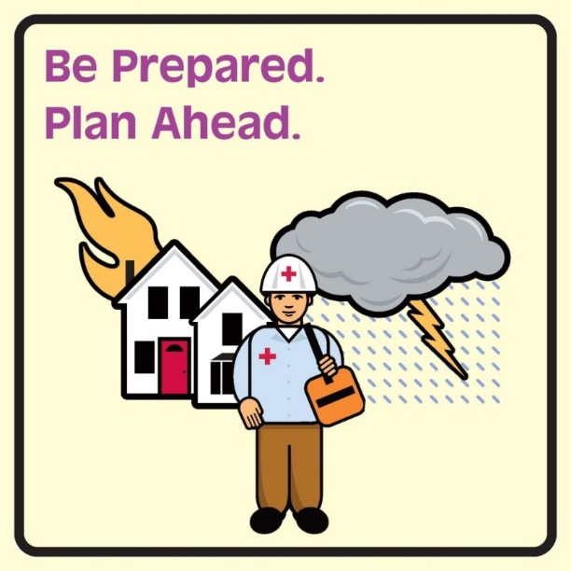
All-Hazards Planning
Applies to a range of emergencies
Identifies common tools and resources
Efficient and effective
Prepare to:
Shelter-in-place
Evacuate
Communicate
Notes:
All-Hazards planning is used by emergency responders to describe the approach of “preparing for a range of emergencies,” from something small and localized to something larger and regional. All-Hazards Planning is an efficient and effective way to plan for emergencies. It identifies tools, strategies, and resources that can be used regardless of what the emergency is.
Individuals and families can also use All-Hazards Planning by identifying the tools, strategies, and resources that they will use in any emergency situation. This community workshop stresses the 2 different actions you may need to take in an emergency: sheltering-in-place or evacuation. In addition, regardless of the emergency or whether one needs to stay in place or evacuate, it is always important to know how to get in touch with friends, relatives, emergency responders, and community resources.

Slide 8
Community Workshop Materials
From www.ReadyNH.gov:
ReadyNH Emergency Kit handouts
ReadyNH Family Emergency Plan handout
ReadyNH Emergency Contact Cards
Slides and Speaker’s notes
Sign in sheet
Evaluations
Sample Go-kit (optional)
Notes:
All of these handouts and files are available at www.ReadyNH.gov.
In addition, if you have access to a sample go-kit, it’s a good visual to bring along for participants to look at.

Slide 9
Community Workshop Prep
Confirm location and time
Prepare workshop materials
Prepare necessary equipment
Test video
Check if you will have internet access at location
Assemble sample go-kit or supplies
Notes:
Here is a list of things you should do to prepare to offer a community workshop.
Confirm location and time
Prepare workshop materials
Prepare necessary equipment
Test video
Check if you will have internet access at location
Assemble sample go-kit or supplies
And now we’re going to switch to the community workshop presentation, and I am going to present the slides as if I was conducting a community workshop so that you can see a sample of how the community workshop could be presented.
Before we move on, does anyone have any questions?

Slide 10
Be ReadyNH!
<Insert Training Location>
<Insert Training Date>
Trainers: <Insert Names>
A Personal Plan for All Emergencies
Notes:
Thank you all of coming to this training. My name is <insert name> and I’m from <insert organization>.
The purpose of this training is to discuss simple strategies for becoming better prepared at home for a range of possible emergencies and disasters.
A community’s response to an emergency is improved when individuals and families are also prepared to address their own needs.

Slide 11
Learning Objectives
After this workshop, participants will be able to:
Understand the importance of personal preparedness
Identify personal barriers to planning
Assess their level of preparedness
Use resources on ReadyNH.gov
Sign up for NH Alerts
Identify steps they can take to develop or improve their emergency plan
Notes:
After this workshop, participants will be able to:
Understand the importance of personal preparedness;
Identify personal barriers to planning;
Assess their level of preparedness;
Use resources on ReadyNH.gov;
Sign up for NH Alerts;
Identify the first 3 steps they should take to develop or improve their emergency plan.

Slide 12
Preparing a Family Emergency Kit (in Plain English)
Notes:
https://youtu.be/RKJ4gwcDI6w?si=Qi4ch4JeBpFRFiWC

Slide 13
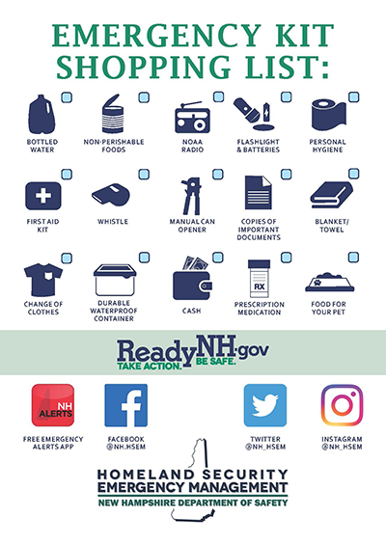
Activity
Complete the Emergency Kit checklist to assess your level of preparedness
Notes:
Lets start by each assessing our own personal level of preparedness.
Pass out or refer participants to ReadyNH’s Emergency kit handout and explain:
Take a few moments to review this sheet and check off the components of an emergency kit that you have on hand.
The survey will help you identify what you have already done to prepare, but more importantly what you must focus on to become better prepared.
Also think about if there are other things that your family has on hand to be prepared, or if there are other things you think your household should have.
Once the self-assessment is complete ask participants about the experience of filling it out.
How many people were able to check off all 15 items?
How many people were able to check off over 10 items?
Did you learn anything about your preparedness efforts from this process?
Can you think of other items that are important to have on hand in the event of an emergency?
Ideas: baby food and formula, cell phone with car charger, house phone that does not use electricity, hand sanitizer, extra set of keys, glasses, cash, activities for kids
It’s not an issue if you weren’t able to check many off – that’s why we’re here today. To work together to improve the preparedness of each of our households and our community as a whole.

Slide 14
Preparedness in NH
How well prepared do you feel your household is to handle a large-scale disaster or emergency?
Well-prepared
Somewhat prepared
Not prepared
32.2%
53.6%
14.1%
Notes:
So, after this mini-assessment of your preparedness, how well prepared do you feel your household is to handle a large-scale disaster or emergency? How many of your feel well-prepared? Somewhat prepared? Not prepared?
This question was asked on the 2013 Behavior Risk Factor Surveillance Survey, which is an annual telephone survey of adults aged 18 or older of NH residents who live independently. (Advance for BRFSS numbers to appear.) 32% of NH residents said they feel well-prepared, 54% of residents said somewhat prepared, and 14% said not prepared. So while about a third of the state is prepared, we still have a lot of work to do to bring the rest of the state up to this level of preparedness.

Slide 15
Approach to Preparedness
Have plans in place to:
Shelter-in-Place
Evacuate
Connect with loved ones
Notes:
It can seem overwhelming to figure out where to start to get prepared. There are so many different kinds of disasters that we need to be ready for. However, we recommend an All-Hazards approach to planning. This is the term used to describe “preparing for a range of emergencies.” All-Hazards Planning is an efficient and effective way to plan for emergencies. It identifies tools, strategies, and resources that can be used regardless of what the emergency is.
By preparing to either shelter-in-place or evacuate, you will be prepared regardless of the emergency. In addition, regardless of what type of emergency it is, it is always important to know how to get in touch with friends. relatives, emergency responders, and community resources.

Slide 16
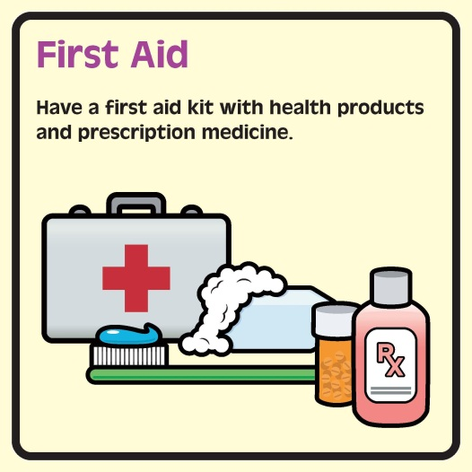
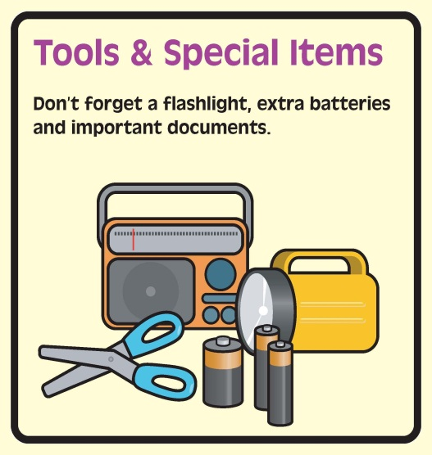
Plan to Shelter-in-Place
Notes:
If you needed to stay in your home for 3 days, which supplies on the checklist would you need? What other supplies would you need? (Some participants may suggest other items that they would include in their supplies. Reinforce that there is no right or wrong answer. Preparing for emergencies is about feeling safe and confident and their supplies should reflect that.)
Ideas:
Water – 1 gallon/person/day – How much does your household need? Don’t forget the pets
Can opener
Battery powered radio and batteries
ABC type fire extinguisher
Smoke & carbon monoxide detectors
Wired phone (not cordless)
First Aid kit
Flashlight & batteries
3-day supply canned or dry foods like beans, pasta, crackers
3-day supply of baby food and formula
Most will find that they already have many of the supplies on the list. We are not asking that people go out and buy a bunch of supplies. More important is to pull together everything that they already have in one place. Then you can add the things that you are missing over time.

Slide 17
Plan to Evacuate
Notes:
Now which of the supplies on the checklist would you need to take with you if you needed to evacuate your home? What other supplies would you need? (Some participants may suggest other items that they would include in their supplies. Reinforce that there is no right or wrong answer. Preparing for emergencies is about feeling safe and confident and their supplies should reflect that.)
Ideas: Clothes, shampoo, feminine hygiene items, diapers, towel, blanket, extra car keys, prepaid card phone, granola bars, water, activity books for kids
It is important that your evacuation kit is ready to go and easy to grab in case you need to leave your home quickly. Do any of you have any tips for how to assemble a go kit, where to store your go-kit, etc.?
Ideas: Store go-kit in garage or near exit, change clothes in go-kit once a year, rotate food in go-kit periodically, check that flashlights, etc. are still working twice a year when you check your fire alarm

Slide 18
Tips for Preparing on a Budget
Have your preparedness shopping list ready and watch for sales
Stockpile tap water
Use the water in your home water heater
Don’t make French toast
Check the dollar store
Set a preparedness budget and purchase items slowly
Notes:
While many of us probably have the majority of these items already on hand, some items may need to be purchased. Preparing doesn’t need to be an expensive endeavor and there are some simple tips you can use to prepare on a budget.
Once you’ve identified the items you need to purchase, make a list and wait for the items to go on sale.
Instead of purchasing the 3 gallons of water per person per day, fill up empty soda and water bottles with tap water. Be sure to thoroughly clean and sanitize the bottles first. Also, when a storm is expected, you can fill your bathtub with water in case you lose water. This water can then be used to wash dishes and flush the toilet so that you don’t need to use your drinkable water for these tasks.
In addition, a typical home water heater can provide 30 or more gallons of clean drinking water. This is a little tricky and the water may be very hot, but you can find further instructions online for how to do this (https://emilms.fema.gov/is909/assets/01_preparednessonashoestring.pdf).
When bad weather is approaching, it seems like everyone’s first instinct is to go buy bread, milk, and eggs. However, milk will go bad pretty quickly if you lose power and eggs need to be cooked. Think about what items your family can prepare with no power, that will be both nutritious and satisfying, and stockpile those foods instead of wasting money on food products that will go bad if you lose power or can’t cook them in time.
Many of the recommended preparedness items can be found at the dollar store or other discount stores.
Finally, you can set a preparedness budget and purchase one item from your preparedness shopping list each time you go shopping or one item per month, whichever is within your budget.

Slide 19
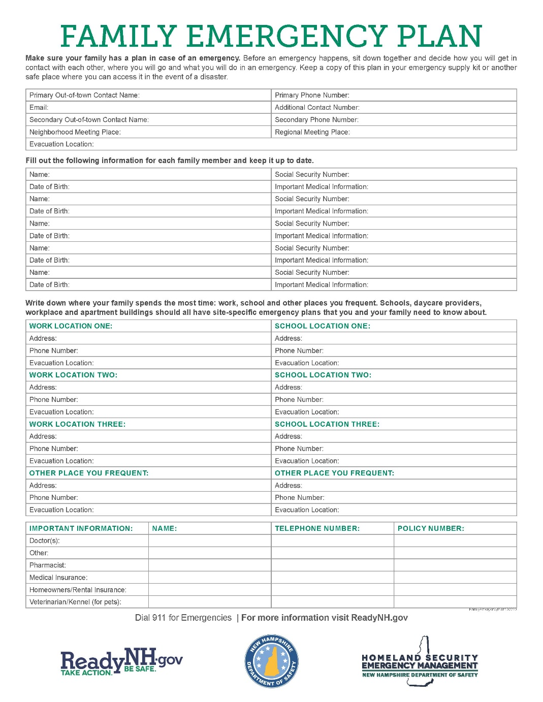
Plan to Connect
Notes:
Regardless of the emergency, it’s important that you are able to contact your loved ones as well as emergency services and other resources.
Pass out or refer participants to ReadyNH’s Family Emergency Plan handout and Emergency Contacts pocket card and explain:
ReadyNH has templates for both a Family Emergency Plan and an Emergency Contacts pocket card that you can use to gather your family’s information in one place, as well as give a portable version of the information to all members of your family.
Are there other items you would like to add to your plan? Ideas: medical vendors, such as oxygen
In addition to having the numbers, addresses, and other information you need to Connect, it’s also important to think about the mechanisms that you will rely on to communicate.
In an emergency, cell phone towers may be overwhelmed by those trying to reach loved ones. When towers are overwhelmed, it is easier to get a text message through than a voice call. In addition, it might be easier to use the internet (e.g., e-mail, social media) to get a message to someone than placing a phone call.
Also, if you have a house phone, does it work when the power goes out?

Slide 20
Sign up for alerts
Local
ReadyNH.gov
FEMA app
Weather app
Notes:
One way you can stay informed of emergencies is to sign up for NH Alerts in order to receive text messages with public safety notices issued by the State of NH and severe weather warnings directly from the National Weather Service.

Slide 21
Sign up for NH Alerts
Screenshots of Genasys
Notes:
You can also download the NH Alerts app (available for both Apple and Android phones) to get push notifications of alerts, see current alerts in NH, and customize your alert settings.

Slide 22
Workplace Preparedness
Shelter-in-place
Evacuate
Alternative work arrangements
Emergency phone tree or other alert system for employees
Other ideas?
Notes:
In addition to preparing your household, it’s also important to take steps to prepare your workplace. You can think of workplace preparedness with a similar all-hazards approach as household preparedness.
If you (and your co-workers) had to stay at your workplace for 3 days, what supplies would you need? Do you have these supplies?
Does your office have fire drills to practice evacuating?
If you were not able to get to your workplace or enter the building for an extended period of time, would you be able to work from home or an alternate site?
Who’s workplace has an emergency phone tree or other alert system to contact employees in an emergency? When has it last been used? Do you ever do drills? Do you keep your phone tree or contact list in an easily accessible place?
If your workplace isn’t prepared, you might want to think about going to your supervisor and talking about how your workplace can take more steps to be prepared.

Slide 23
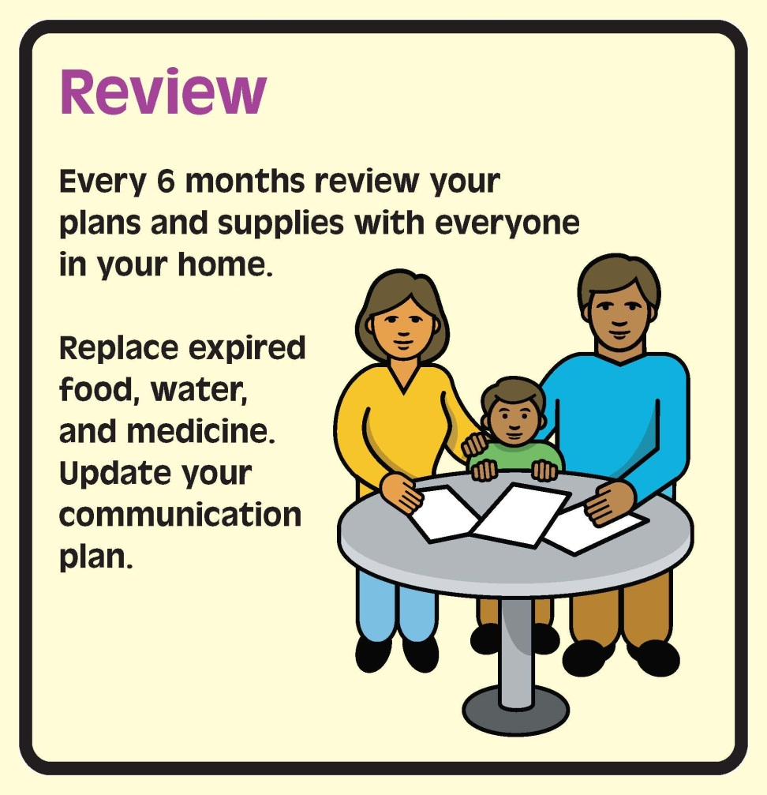
Review Your Plan and Kit
Notes:
Once you develop your plan and emergency kit, it’s important to revisit it every 6 months with everyone in your home to make sure it is still up to date and everyone knows what the plan is.
Keep in mind that food and medications expire and phone numbers change.

Slide 24
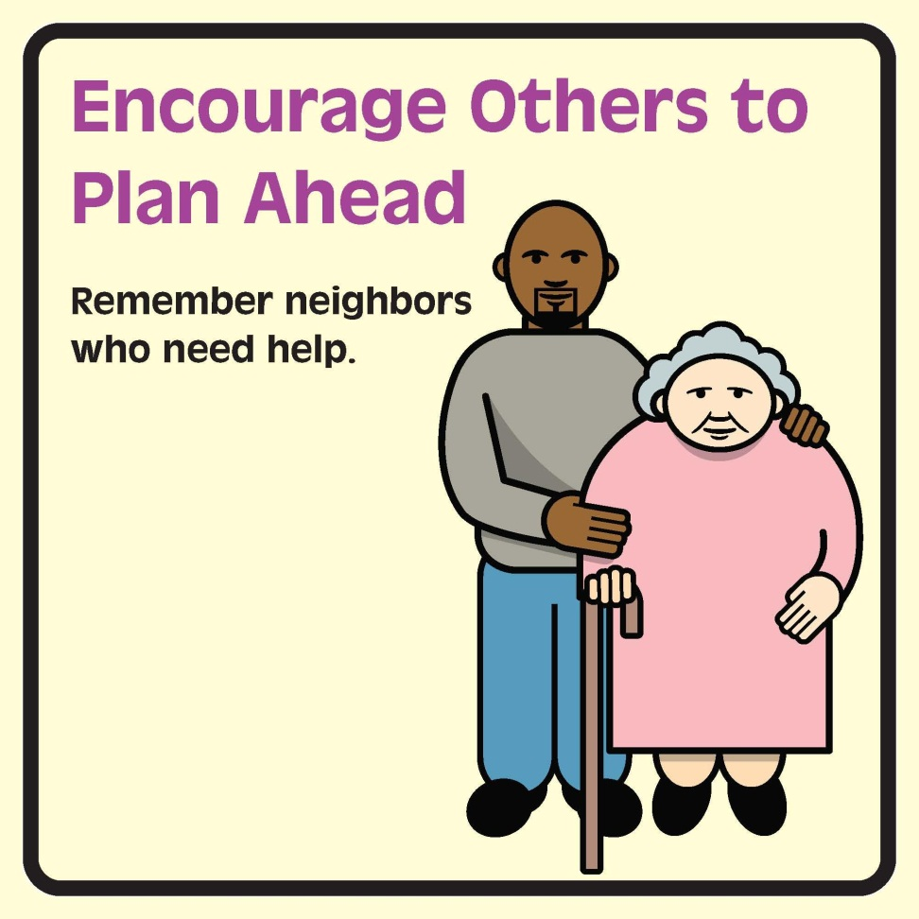
Support Others
Notes:
Once you are prepared, we also ask that you help others prepare. Talk to your neighbors, relatives, and friends about their plans, and give them advice on how to get started. In addition, think of your neighbors that might need extra help preparing and during an emergency. Perhaps you have a neighbor that has trouble leaving their house or apartment, or who doesn’t have a car. Consider building checking on these neighbors into your household emergency plan.
Community preparedness is improved when we work with our neighbors, family, and friends to ensure that everyone is better prepared.

Slide 25
Notes:
All of the materials we’ve used today, including these slides, are available at the ReadyNH website. There is also a lot of other valuable information there, so I encourage you to explore the website.

Slide 26
Questions?
Please complete your evaluation!

Slide 27
Facilitation Tips I
Ask open-ended questions
Make sure the questions you ask are questions you would answer
Be supportive and non-judgmental – remind people there are no right or wrong answers
Notes:
So that last slide is the end of the community workshop, but we have a few more tips we want to share with you before you go off and present this training to others.

Slide 28
Facilitation Tips II
Do not defend or argue if there is disagreement – ask more questions
Repeat what the person said and summarize ideas
Affirm/acknowledge attempts to prepare
Do not make assumptions about peoples’ needs
Notes:
[this was left blank intentionally]

Slide 29
Brainstorming Activity
Where could you offer this workshop?
Notes:
BRAINSTORM Activity: Ask participants to list potential locations/venues for offering this type of workshop.
Ideas:
Schools
Book groups
Rec groups
Neighbor Watch Associations
Worksite wellness groups or worksite safety groups
Church groups
Senior centers
Staff meetings

Slide 30
Questions?
Please complete your evaluation!
Notes:
[this was left blank intentionally]

Slide 31
Special Thanks to . . .
Developed in collaboration with the Community Health Institute, NH DHHS, NH HSEM, VolunteerNH, the American Red Cross, and the Public Health Networks based on material developed by the Cambridge Advance Practice Center for Emergency Preparedness through a cooperative agreement from CDC to NACCHO. These materials do not necessarily represent the official views of CDC or NACCHO.
Notes:
[this was left blank intentionally]

