Slide 1
A Personal Plan for All Emergencies - Be Ready, NH!
<Insert Training Location> <Insert Training Date> Trainers: <Insert Names>
Notes:
Note: A recommended script for the presenter is included here in the notes section throughout these slides. Instructions to Speakers are included in italics.

Slide 2
Learning Objectives
After this workshop, participants will be able to:
Understand the importance of personal preparedness
Identify personal barriers to planning
Assess their level of preparedness
Use resources on ReadyNH.gov
Sign up for NH Alerts
Identify steps they can take to develop or improve their emergency plan
Notes:
After this workshop, participants will be able to:
Understand the importance of personal preparedness;
Identify personal barriers to planning;
Assess their level of preparedness;
Use resources on ReadyNH.gov;
Sign up for NH Alerts;
Identify the first 3 steps they should take to develop or improve their emergency plan.

Slide 3
Preparing a Family Emergency Kit (in Plain English)
Notes:
https://youtu.be/RKJ4gwcDI6w?si=Qi4ch4JeBpFRFiWC

Slide 4
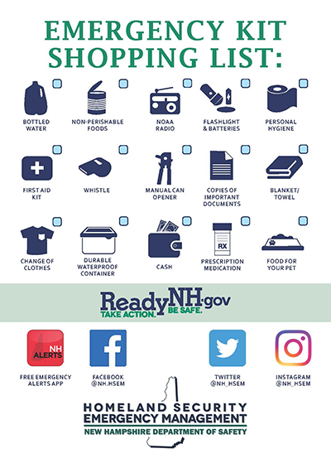
Activity
Complete the Emergency Kit checklist to assess your level of preparedness
Notes:
Lets start by each assessing our own personal level of preparedness.
Pass out or refer participants to ReadyNH’s Emergency kit handout and explain:
Take a few moments to review this sheet and check off the components of an emergency kit that you have on hand.
The survey will help you identify what you have already done to prepare, but more importantly what you must focus on to become better prepared.
Also think about if there are other things that your family has on hand to be prepared, or if there are other things you think your household should have.
Once the self-assessment is complete ask participants about the experience of filling it out.
How many people were able to check off all 15 items?
How many people were able to check off over 10 items?
Did you learn anything about your preparedness efforts from this process?
Can you think of other items that are important to have on hand in the event of an emergency?
Ideas: baby food and formula, cell phone with car charger, house phone that does not use electricity, hand sanitizer, extra set of keys, glasses, cash, activities for kids
It’s not an issue if you weren’t able to check many off – that’s why we’re here today. To work together to improve the preparedness of each of our households and our community as a whole.

Slide 5
Approach to Preparedness
Have plans in place to:
Shelter-in-Place
Evacuate
Connect with loved ones
Notes:
It can seem overwhelming to figure out where to start to get prepared. There are so many different kinds of disasters that we need to be ready for. However, we recommend an All-Hazards approach to planning. This is the term used to describe “preparing for a range of emergencies.” All-Hazards Planning is an efficient and effective way to plan for emergencies. It identifies tools, strategies, and resources that can be used regardless of what the emergency is.
By preparing to either shelter-in-place or evacuate, you will be prepared regardless of the emergency. In addition, regardless of what type of emergency it is, it is always important to know how to get in touch with friends. relatives, emergency responders, and community resources.

Slide 6
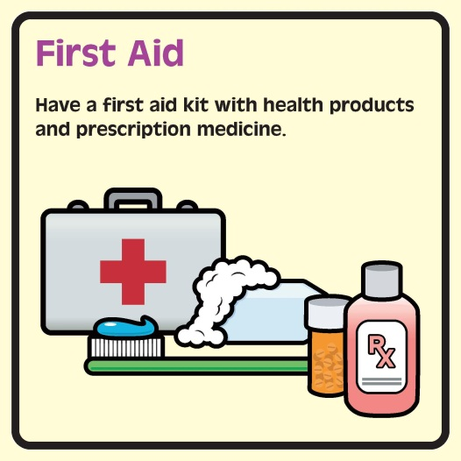
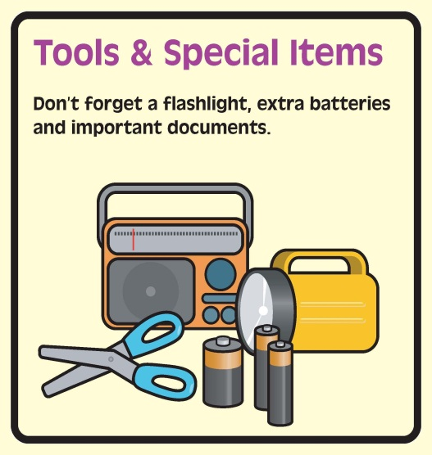
Plan to Shelter-in-Place
Notes:
If you needed to stay in your home for 3 days, which supplies on the checklist would you need? What other supplies would you need? (Some participants may suggest other items that they would include in their supplies. Reinforce that there is no right or wrong answer. Preparing for emergencies is about feeling safe and confident and their supplies should reflect that.)
Ideas:
Water – 1 gallon/person/day – How much does your household need? Don’t forget the pets
Can opener
Battery powered radio and batteries
ABC type fire extinguisher
Smoke & carbon monoxide detectors
Wired phone (not cordless)
First Aid kit
Flashlight & batteries
3-day supply canned or dry foods like beans, pasta, crackers
3-day supply of baby food and formula
Most will find that they already have many of the supplies on the list. We are not asking that people go out and buy a bunch of supplies. More important is to pull together everything that they already have in one place. Then you can add the things that you are missing over time.

Slide 7
Plan to Evacuate
Notes:
Now which of the supplies on the checklist would you need to take with you if you needed to evacuate your home? What other supplies would you need? (Some participants may suggest other items that they would include in their supplies. Reinforce that there is no right or wrong answer. Preparing for emergencies is about feeling safe and confident and their supplies should reflect that.)
Ideas: Clothes, shampoo, feminine hygiene items, diapers, towel, blanket, extra car keys, prepaid card phone, granola bars, water, activity books for kids
It is important that your evacuation kit is ready to go and easy to grab in case you need to leave your home quickly. Do any of you have any tips for how to assemble a go kit, where to store your go-kit, etc.?
Ideas: Store go-kit in garage or near exit, change clothes in go-kit once a year, rotate food in go-kit periodically, check that flashlights, etc. are still working twice a year when you check your fire alarm

Slide 8
Tips for Preparing on a Budget
Have your preparedness shopping list ready and watch for sales
Stockpile tap water
Use the water in your home water heater
Don’t make French toast
Check the dollar store
Set a preparedness budget and purchase items slowly
Notes:
While many of us probably have the majority of these items already on hand, some items may need to be purchased. Preparing doesn’t need to be an expensive endeavor and there are some simple tips you can use to prepare on a budget.
Once you’ve identified the items you need to purchase, make a list and wait for the items to go on sale.
Instead of purchasing the 3 gallons of water per person per day, fill up empty soda and water bottles with tap water. Be sure to thoroughly clean and sanitize the bottles first. Also, when a storm is expected, you can fill your bathtub with water in case you lose water. This water can then be used to wash dishes and flush the toilet so that you don’t need to use your drinkable water for these tasks.
In addition, a typical home water heater can provide 30 or more gallons of clean drinking water. This is a little tricky and the water may be very hot, but you can find further instructions online for how to do this (https://emilms.fema.gov/is909/assets/01_preparednessonashoestring.pdf).
When bad weather is approaching, it seems like everyone’s first instinct is to go buy bread, milk, and eggs. However, milk will go bad pretty quickly if you lose power and eggs need to be cooked. Think about what items your family can prepare with no power, that will be both nutritious and satisfying, and stockpile those foods instead of wasting money on food products that will go bad if you lose power or can’t cook them in time.
Many of the recommended preparedness items can be found at the dollar store or other discount stores.
Finally, you can set a preparedness budget and purchase one item from your preparedness shopping list each time you go shopping or one item per month, whichever is within your budget.

Slide 9
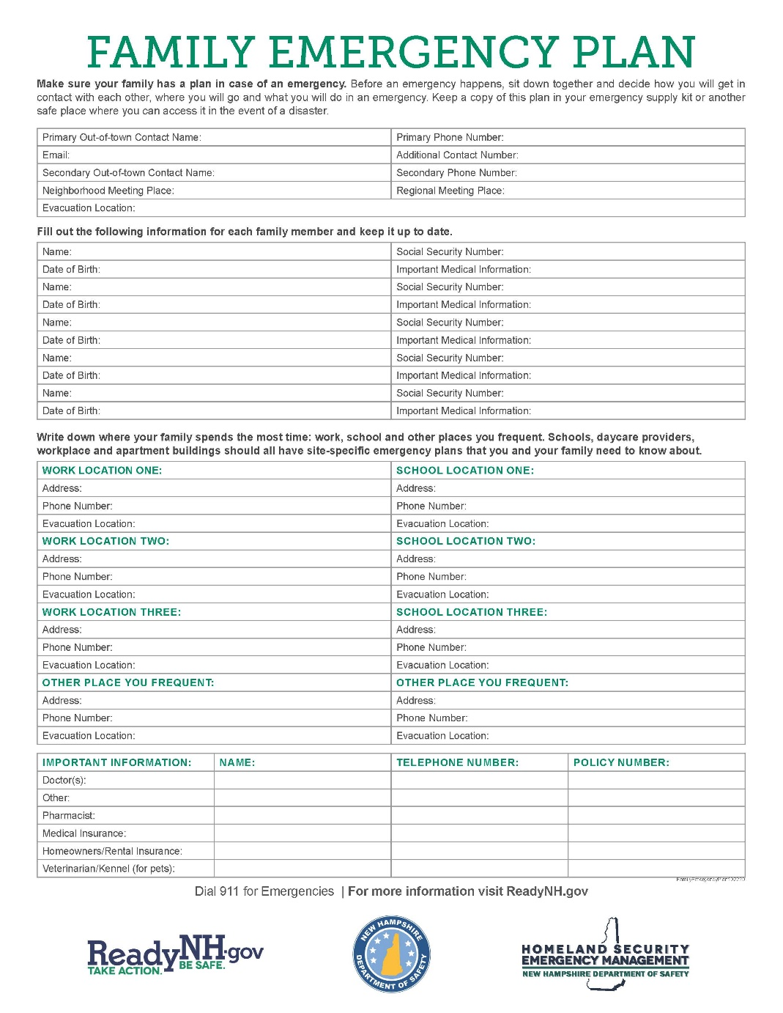
Plan to Connect
Notes:
Regardless of the emergency, it’s important that you are able to contact your loved ones as well as emergency services and other resources.
Pass out or refer participants to ReadyNH’s Family Emergency Plan handout and Emergency Contacts pocket card and explain:
ReadyNH has templates for both a Family Emergency Plan and an Emergency Contacts pocket card that you can use to gather your family’s information in one place, as well as give a portable version of the information to all members of your family.
Are there other items you would like to add to your plan? Ideas: medical vendors, such as oxygen
In addition to having the numbers, addresses, and other information you need to Connect, it’s also important to think about the mechanisms that you will rely on to communicate.
In an emergency, cell phone towers may be overwhelmed by those trying to reach loved ones. When towers are overwhelmed, it is easier to get a text message through than a voice call. In addition, it might be easier to use the internet (e.g., e-mail, social media) to get a message to someone than placing a phone call.
Also, if you have a house phone, does it work when the power goes out?

Slide 10
Sign up for alerts
Local
ReadyNH.gov
FEMA app
Weather app
Notes:
One way you can stay informed of emergencies is to sign up for NH Alerts in order to receive text messages with public safety notices issued by the State of NH and severe weather warnings directly from the National Weather Service.

Slide 11
Stay informed
Sign up for your local alert system
Monitor the weather
Notes:
You can also download the NH Alerts app (available for both Apple and Android phones) to get push notifications of alerts, see current alerts in NH, and customize your alert settings.

Slide 12
Workplace Preparedness
Shelter-in-place
Evacuate
Alternative work arrangements
Emergency phone tree or other alert system for employees
Other ideas?
Notes:
In addition to preparing your household, it’s also important to take steps to prepare your workplace. You can think of workplace preparedness with a similar all-hazards approach as household preparedness.
If you (and your co-workers) had to stay at your workplace for 3 days, what supplies would you need? Do you have these supplies?
Does your office have fire drills to practice evacuating?
If you were not able to get to your workplace or enter the building for an extended period of time, would you be able to work from home or an alternate site?
Who’s workplace has an emergency phone tree or other alert system to contact employees in an emergency? When has it last been used? Do you ever do drills? Do you keep your phone tree or contact list in an easily accessible place?
If your workplace isn’t prepared, you might want to think about going to your supervisor and talking about how your workplace can take more steps to be prepared.

Slide 13
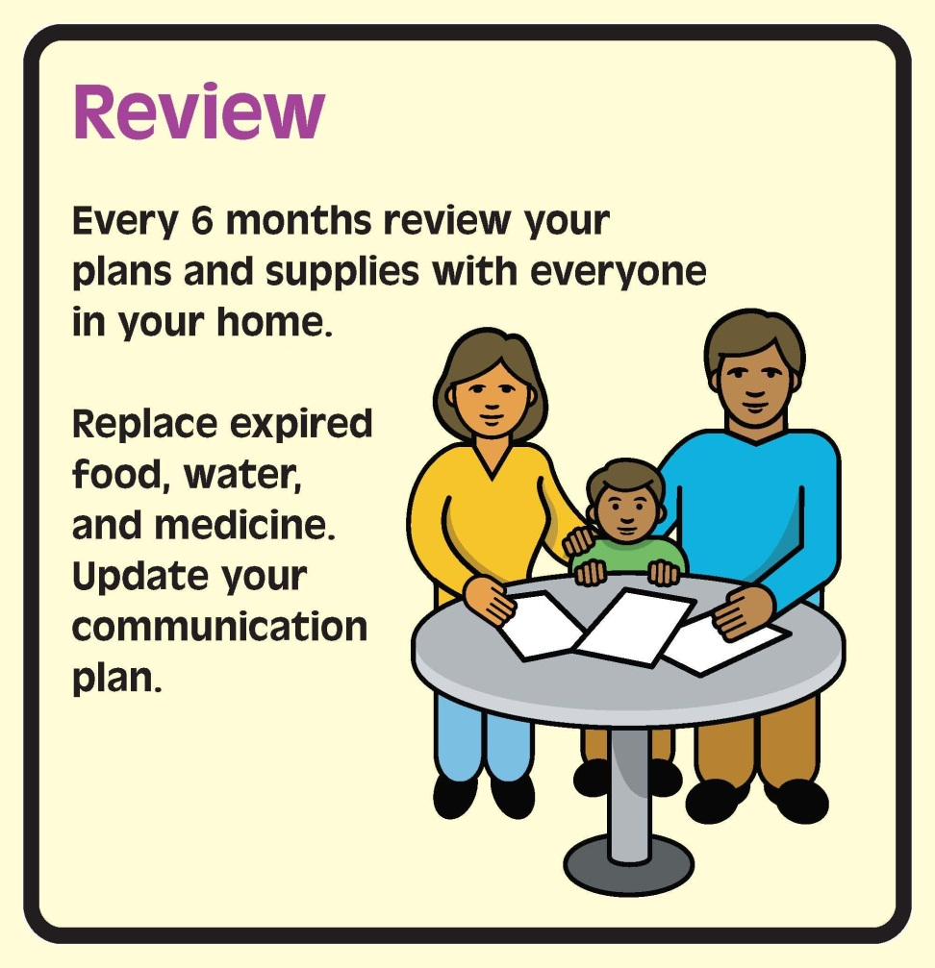
Review Your Plan and Kit
Notes:
Once you develop your plan and emergency kit, it’s important to revisit it every 6 months with everyone in your home to make sure it is still up to date and everyone knows what the plan is.
Keep in mind that food and medications expire and phone numbers change.

Slide 14
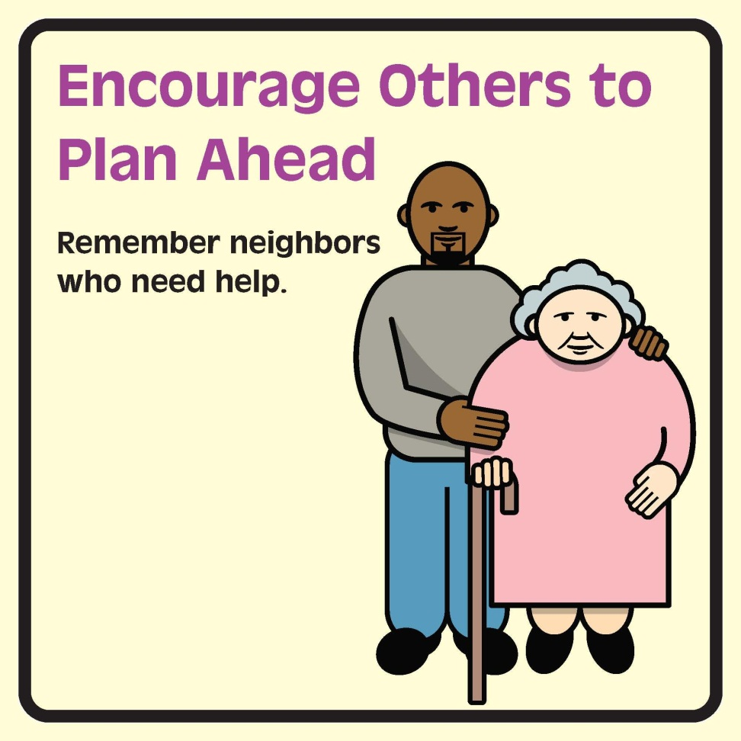
Support Others
Notes:
Once you are prepared, we also ask that you help others prepare. Talk to your neighbors, relatives, and friends about their plans, and give them advice on how to get started. In addition, think of your neighbors that might need extra help preparing and during an emergency. Perhaps you have a neighbor that has trouble leaving their house or apartment, or who doesn’t have a car. Consider building checking on these neighbors into your household emergency plan.
Community preparedness is improved when we work with our neighbors, family, and friends to ensure that everyone is better prepared.

Slide 15
Notes:
All of the materials we’ve used today, including these slides, are available at the ReadyNH website. There is also a lot of other valuable information there, so I encourage you to explore the website.

Slide 16
Questions?
Please complete your evaluation!

Slide 17
Special Thanks to . . .
Developed in collaboration with the Community Health Institute, NH DHHS, NH HSEM, VolunteerNH, the American Red Cross, and the Public Health Networks based on material developed by the Cambridge Advance Practice Center for Emergency Preparedness through a cooperative agreement from CDC to NACCHO. These materials do not necessarily represent the official views of CDC or NACCHO.
Notes:
[this was left blank intentionally]

